Slide 1
Robotics & Artificial Intelligence

Slide 2
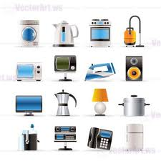
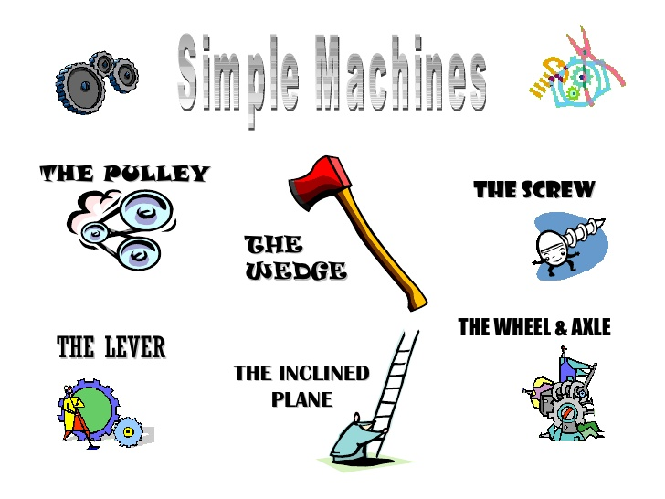
Machines
Repeats a set of tasks
Cannot think for itself and adapt to different situations

Slide 3
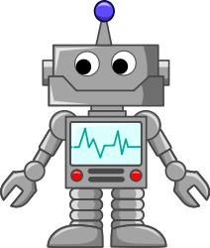
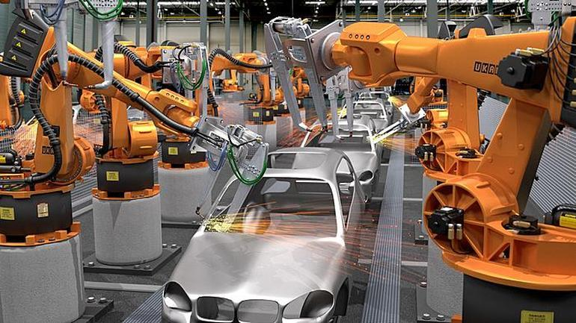
Robots
Is a machine that does tasks without the need of a human
Is programmable but can only do what a human has programmed it to do
More intelligent than machines

Slide 4
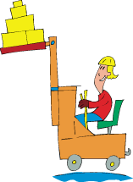
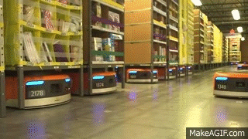
Machine
Robot
Notes:
Pretend we are working in a factory and we need to get some boxes from 2 different sides of the factory. Before, we would use machines like forklifts that require humans to operate it like driving it around. However, nowadays, we can use robots to do that like these robots are doing on the screen. These specific robots are used in Amazon warehouses and have been programmed to move boxes around. They are also able to adapt to new situations and obstacles such as having another robot in the way so they don’t smash right into each other.

Slide 5
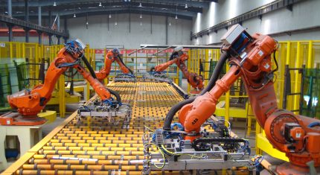
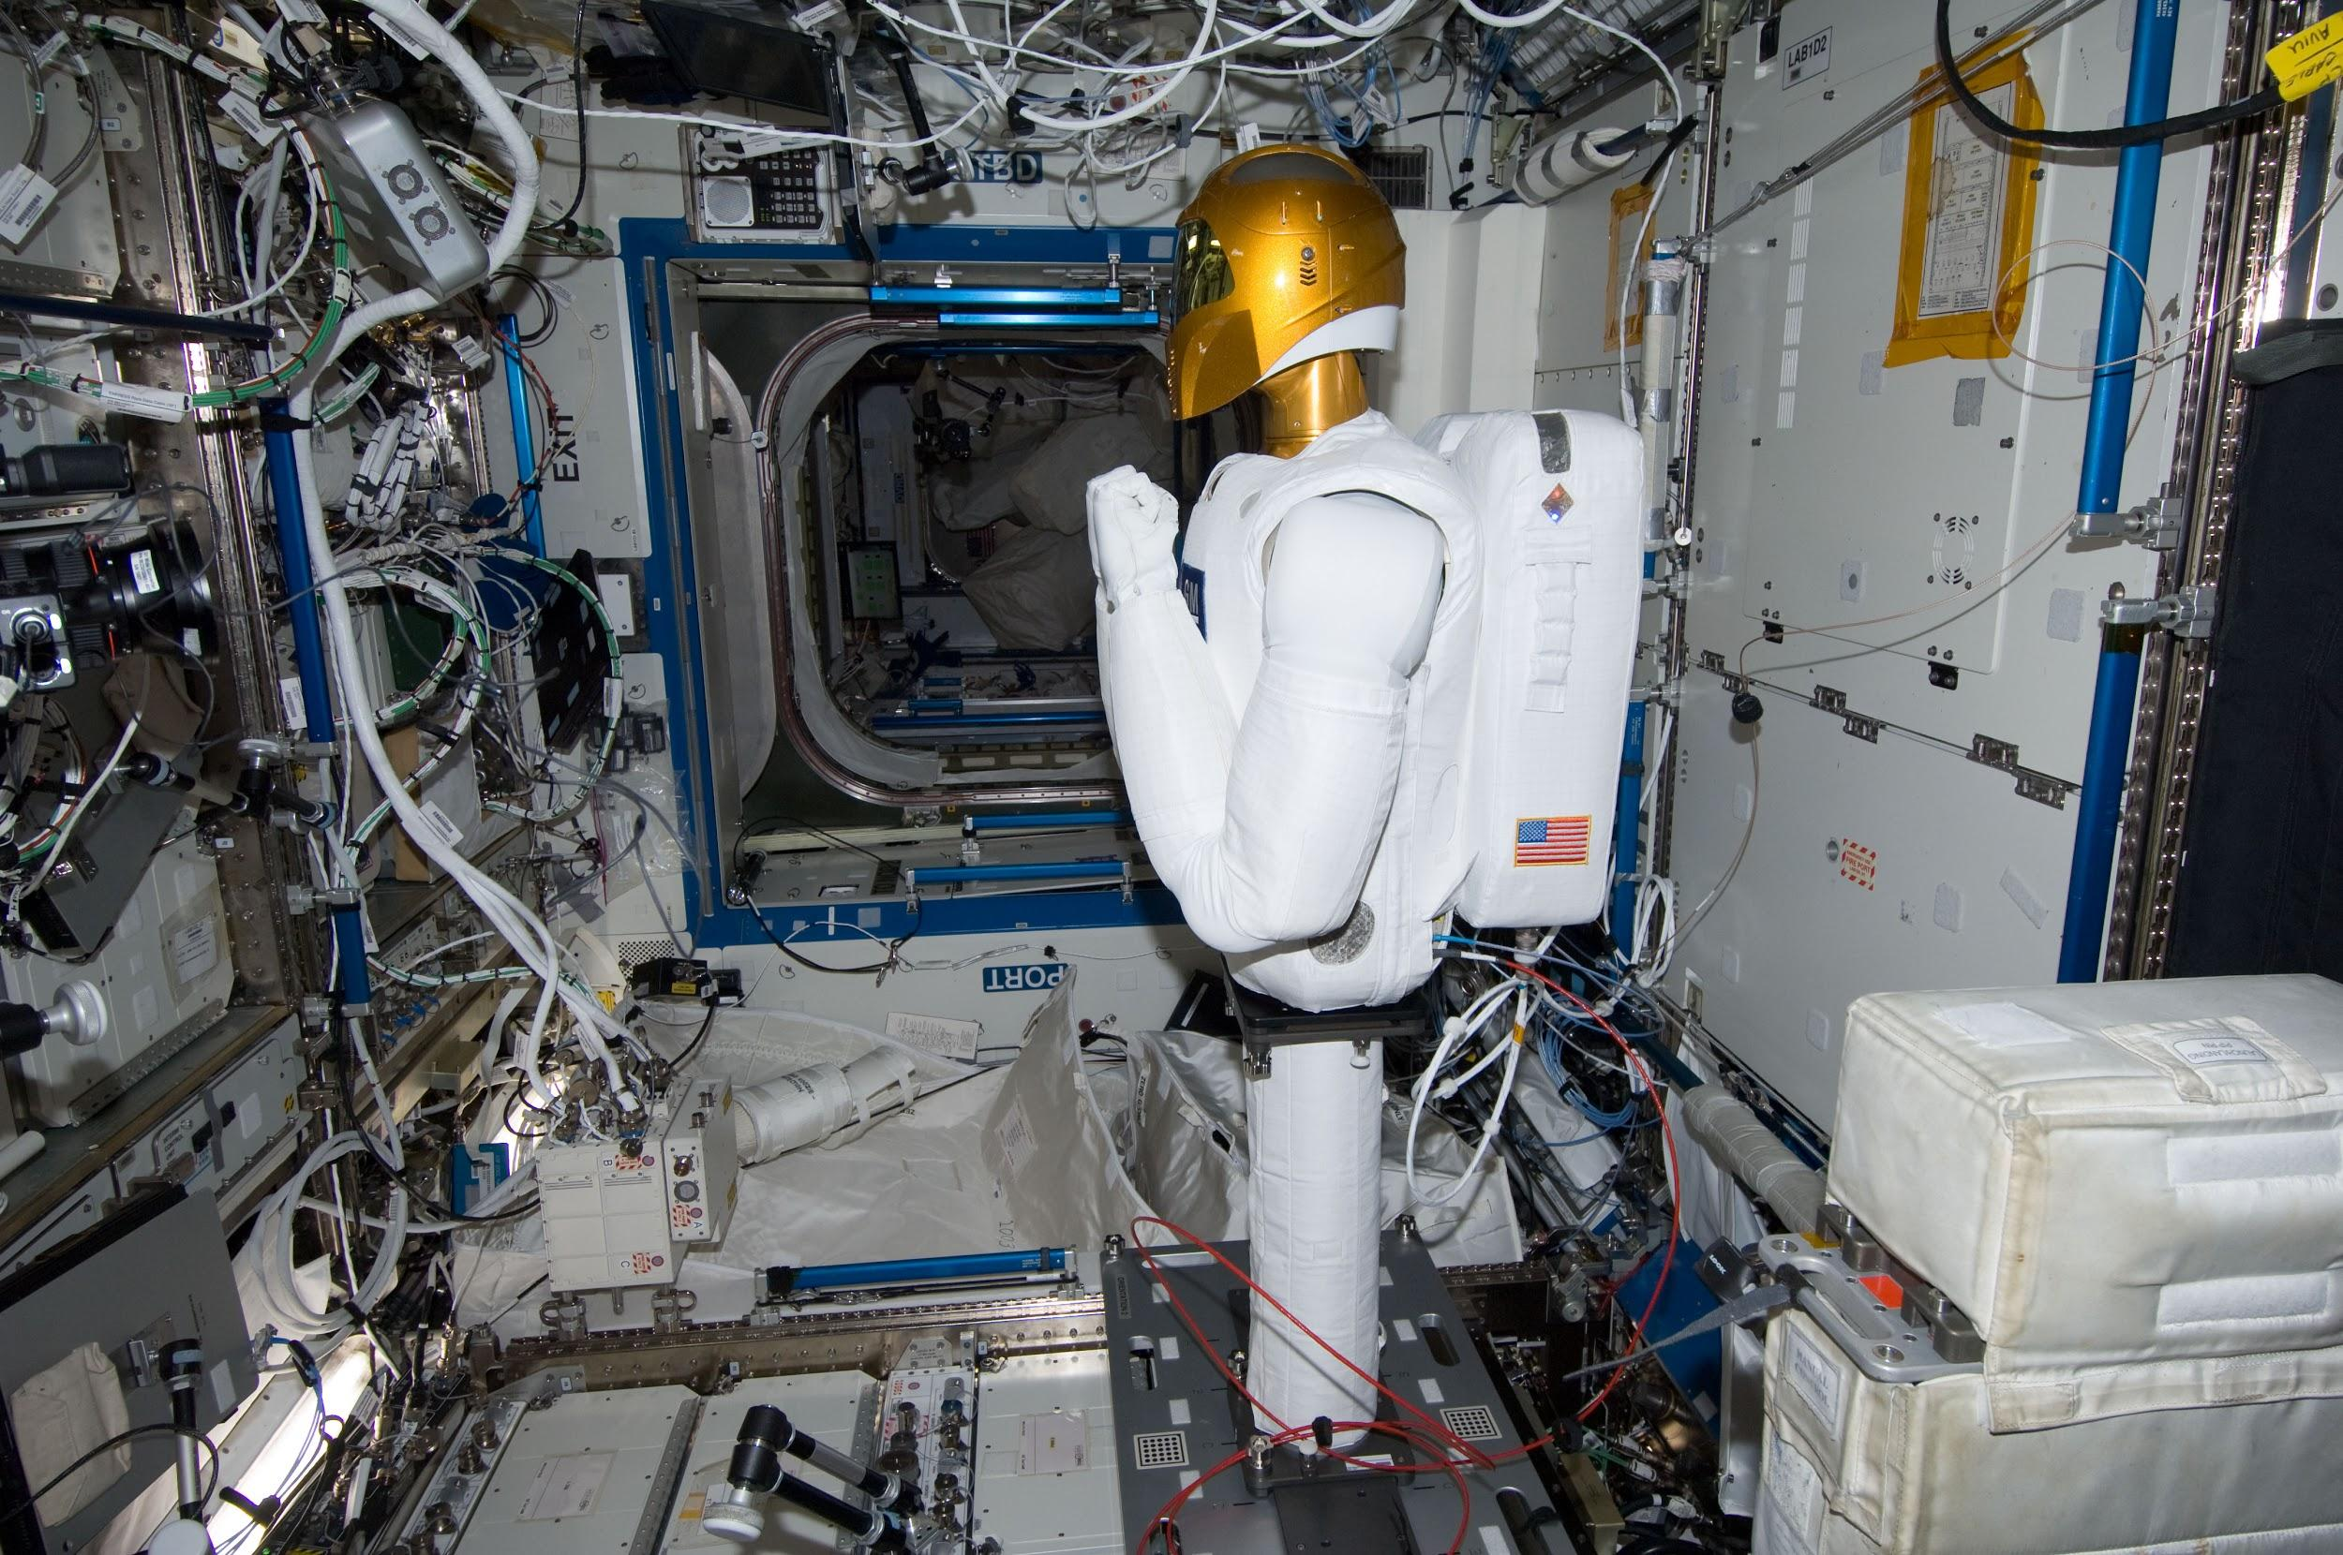
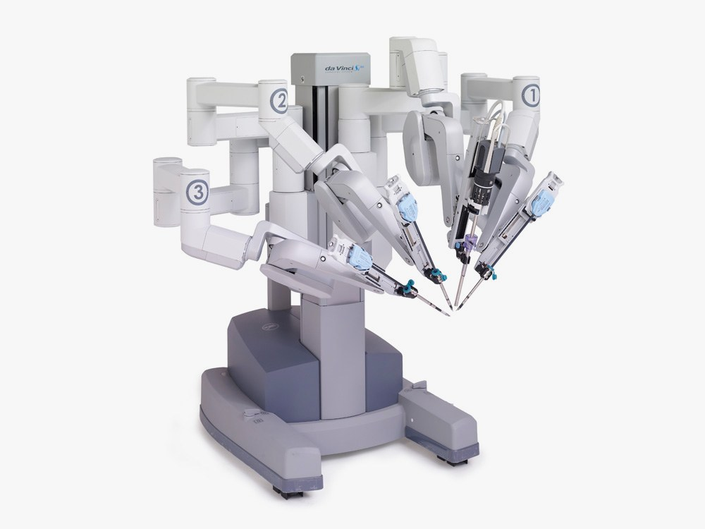
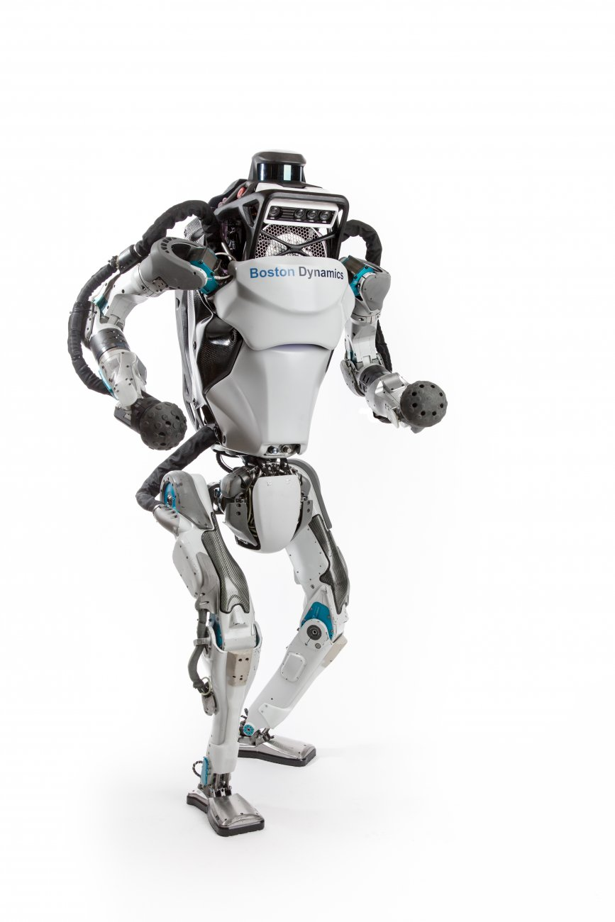
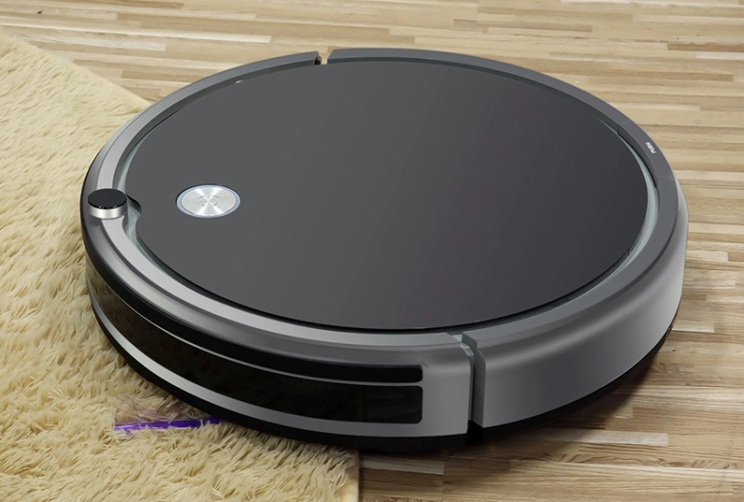
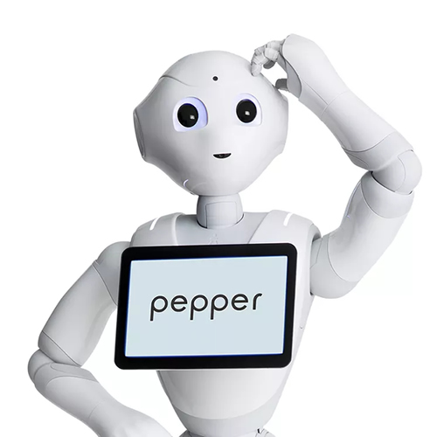
Notes:
First image: industrial robots used in factories
Second image: robonaut 2 in this ISS
Third image: robots are now being used in surgery
First botton robot: Atlas; the world’s most dynamic humanoid
Second botton robot: robot vacuum
Third botton robot: Pepper, designed and programmed to understand and respond to human emotions, the bot adapts itself according to the behavior of his speaker.

Slide 6
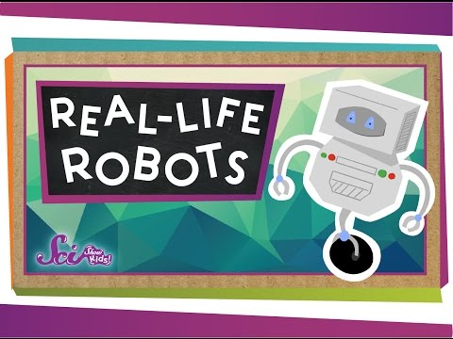

Slide 7
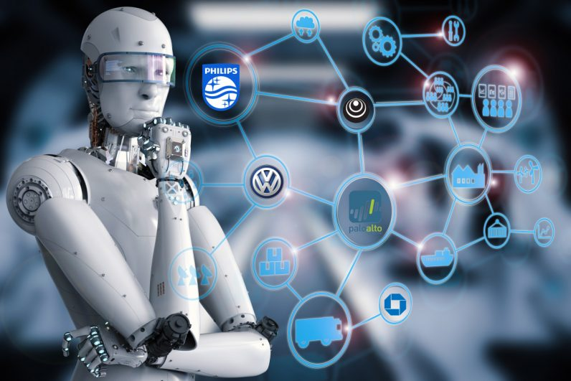
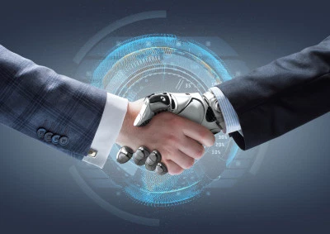
What is AI?
A field of computer science
Building machines which are capable of thinking like humans
Notes:
Field of computer science - AI is not the machine, it creates the intelligence that is in machines

Slide 8
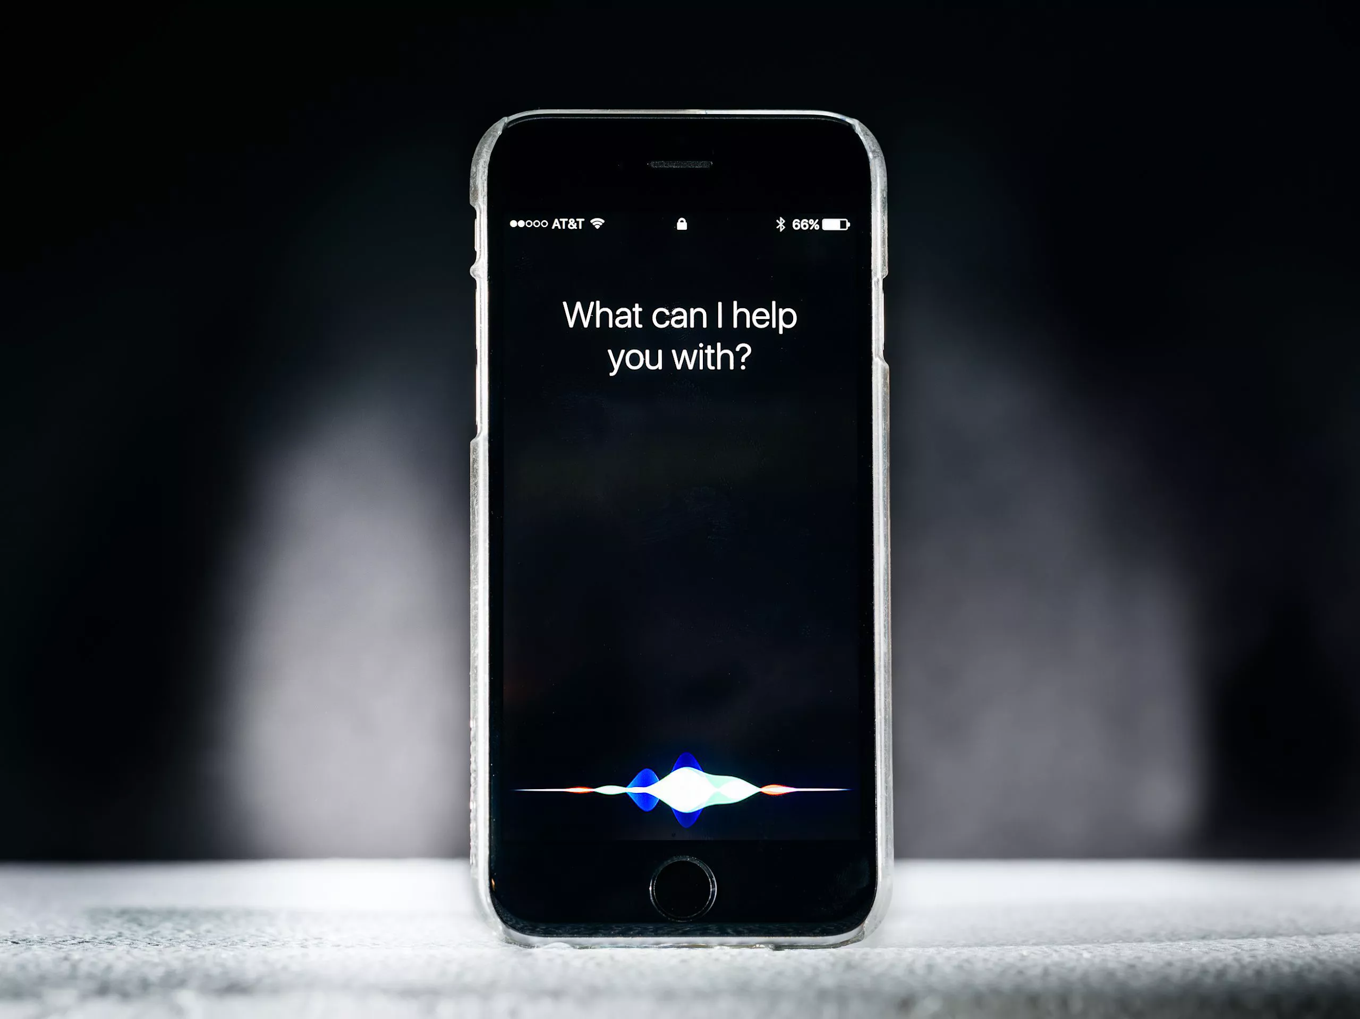
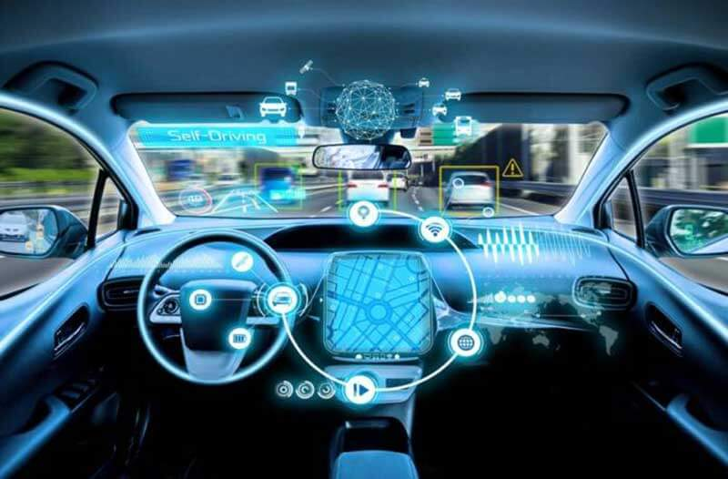


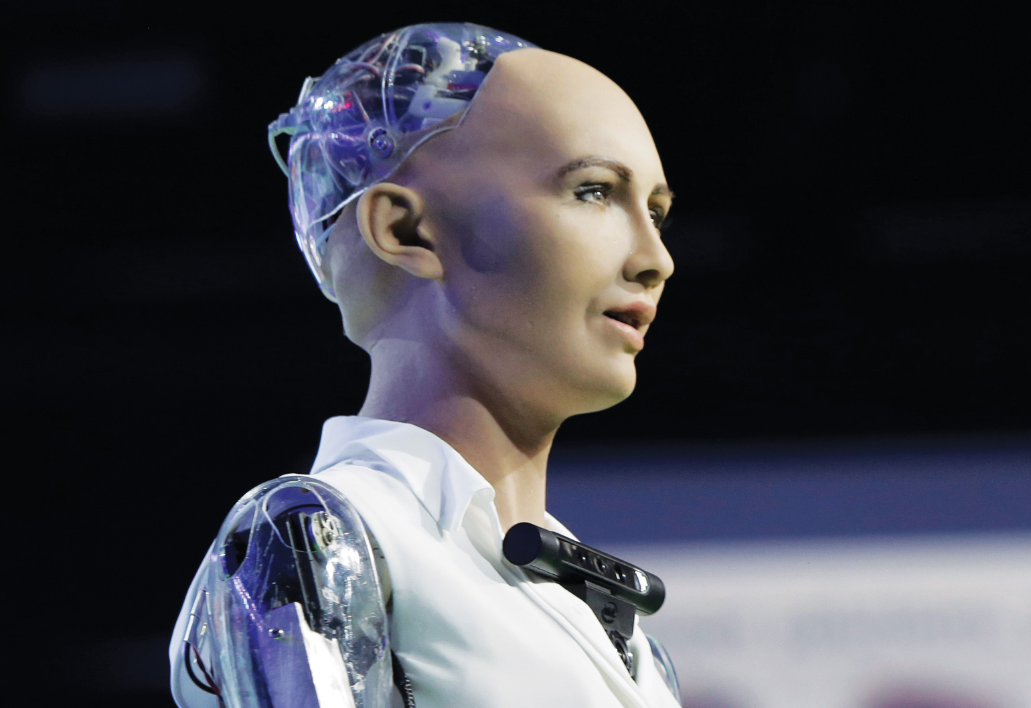

Notes:
Need to explain each picture

Slide 9
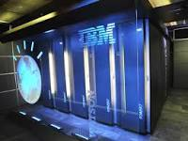
IBM Watson
IBM Watson is a question answering computer system which can answer questions in a common language.

Slide 10
How it works?

Slide 11
What is an algorithm?
An algorithm is a list of rules/steps to follow in order to accomplish a task.

Slide 12


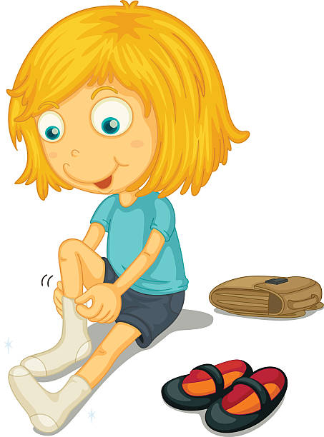
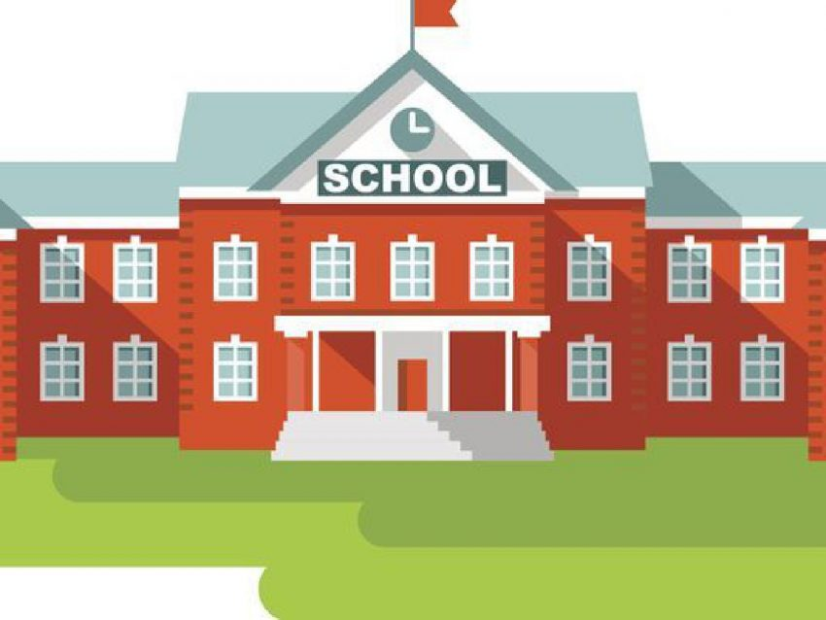
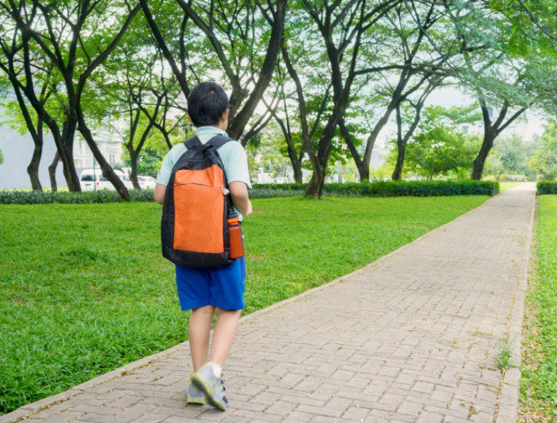
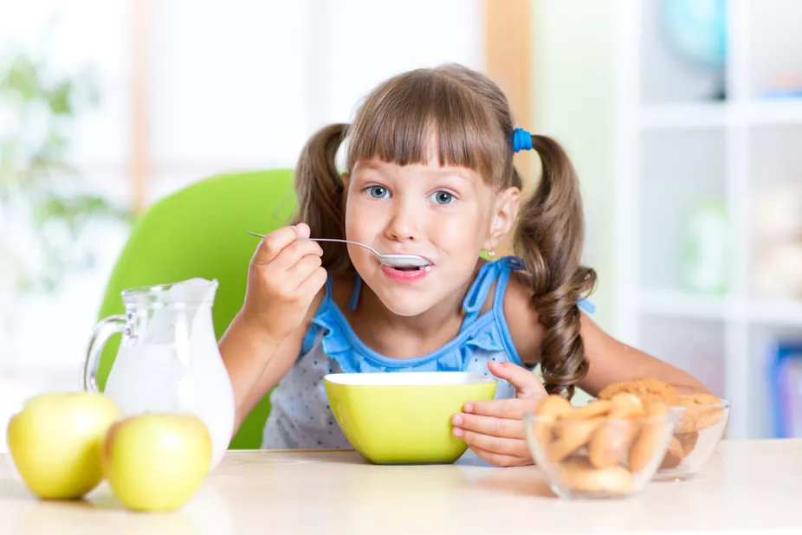

Slide 13
Machine Learning
Learn how to do tasks without a human programming it
Allows computers the ability to learn from data, and then make decision and predictions without being programmed by a human
Allows the computer to adapt to new situations
Notes:
Just like how babies start off knowing nothing, then they gradually learn how to walk and talk, computers also have the ability to learn
Need to explain- find more information to explain thoroughly
Machine Learning: algorithms that give computers the ability to learn from data, and then make decisions and predictions. Machine learning is a set of techniques to achieve the goal of AI. At the crux of AI.
https://www.youtube.com/watch?v=f_uwKZIAeM0
Make decisions and predictions about data
Sophisticated and complex algorithms
Classifier algorithms to categorize e.g. what type of…
Minimal error
‘provides systems the ability to automatically learn and improve from experience without being explicitly programmed. Machine learning focuses on the development of computer programs that can access data and use it learn for themselves.’

Slide 14
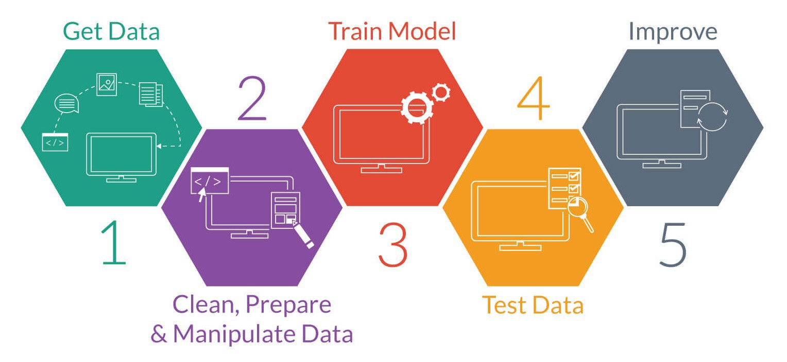
Notes:
This picture represents the steps of machine learning.

Slide 15
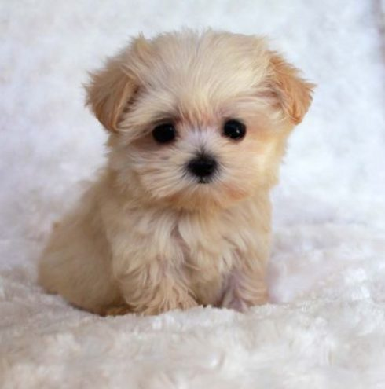

Example
Notes:
You need a computer to figure out the difference between a puppy and a kitten. Using our skills in machine learning, we would give the computer data. For example, we could give it images and tell the computer that this is a puppy and this one’s a kitten. Then, the computer would use this data and find trends in the data so that, next time it sees an image of either a puppy or a kitten, it would be able to recognise whether it is a puppy or a kitten. You would have gone through a similar process when you were younger to see examples of puppies and kittens and then be able to tell which is which.
Going back to our example of dogs and cats. Remember how we showed the computer images of puppies and kittens and we also told the computer if the image was of a puppy or a cat, this is supervised learning because we fed the computer data which was already labelled as either a puppy or a kitten.
Task is being able to identify a puppy or a kitten

Slide 16
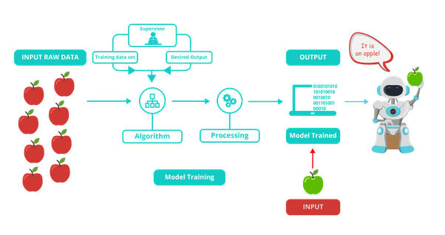
Supervised Learning
Supervised learning is the algorithm learning how to accomplish a task from data already labelled and categorised.

Slide 17
Example
Notes:
Going back to our example of dogs and cats. This time, instead of feeding the computer with labelled data which are the images we have already told the computer is a puppy or kitten, we will still show the computer the pictures, but we won’t tell it whether it is a puppy or a kitten, the computer needs to figure it out itself

Slide 18
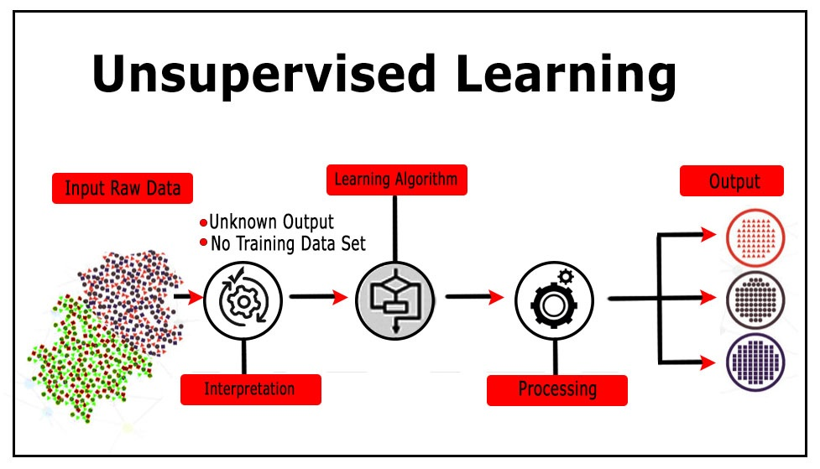
Unsupervised Learning
Unsupervised learning is when an algorithm is given data to act on but the data is uncategorised and unlabelled.

Slide 19
Example
Notes:
So now our computer has used either supervised learning or unsupervised learning and has now come up with an algorithm that recognises puppies and kittens. Pretend we test the computer with a picture of a puppy and mistakenly identifies it as a kitten, we will tell the computer that ‘no, you got it wrong, it is actually a puppy’ and the computer uses this feedback to alter its algorithm so that next time the computer can use its new and improved algorithm so that it has a higher chance of correctly identifying whether it is a puppy or a kitten.

Slide 20
Reinforcement Learning
Reinforcement learning is a training method based on rewarding desired behaviors and/or punishing undesired ones.

Slide 21
AI is always learning and understanding!
https://experiments.withgoogle.com/quick-draw

Slide 22
Why we need it?
Generates a higher degree of efficiency and productivity
Automates repetitive tasks
Creates an immersive, personalised and interactive experiences
AI can better read, understand and utilise the vast amount of data
Notes:
3rd dot point - reference netflix

Slide 23
