Slide 1
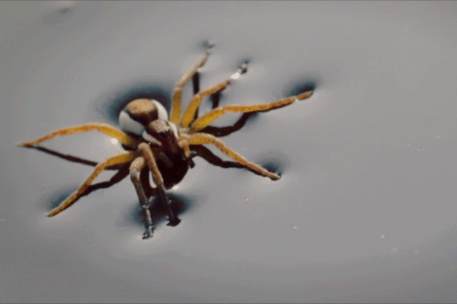

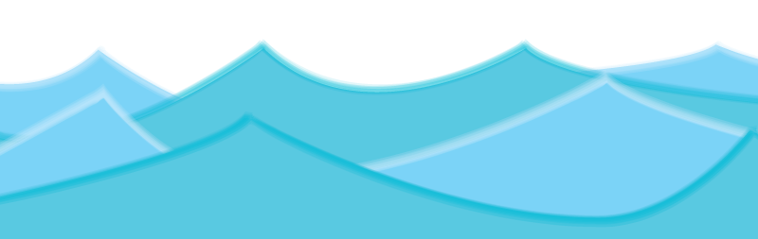
Surface Tension
By Inaya & Areeba
The only good kind of Tension: SURFACE TENSION!!!!!

Slide 2
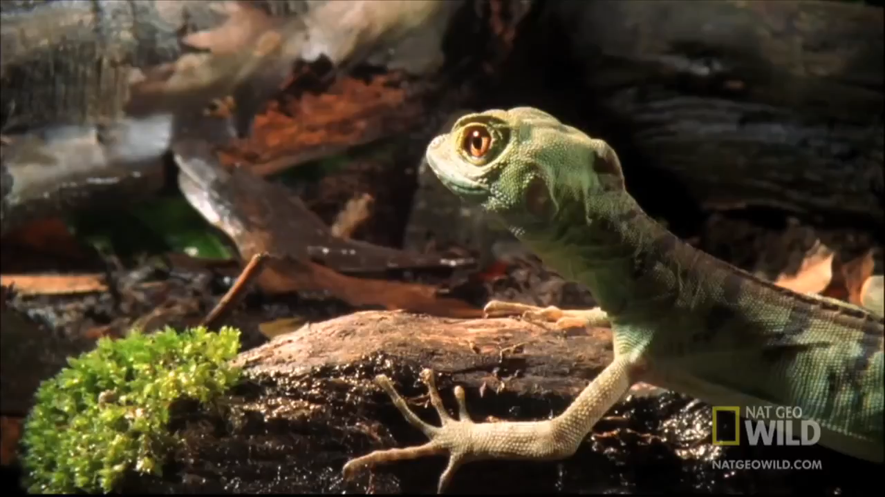

Slide 3
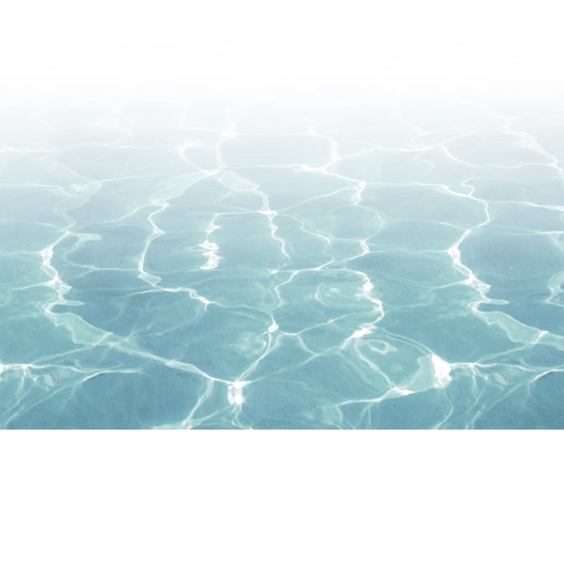
What is Surface Tension
Surface tension is the ability of a liquid to allow objects to float on top of it.
It is the force present within the surface layer of a liquid that causes the layer to act as an elastic sheet and resist other forces.
It’s the effect where the surface of a liquid is strong and can hold up a weight
Many objects can float due to surface tension, even though they normally could not float

Slide 4
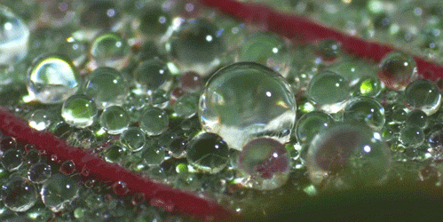
Cohesion
Cohesion(which just means to be able to stick together) refers to the attraction of molecules that are the same. For e.g Water is attracted to Water
Just like you hang out with your friends, water molecules, or small particles of water have strong ‘cohesive’ forces and therefore stick to other water molecules.
It is because of Cohesion that we have Surface Tension

Slide 5
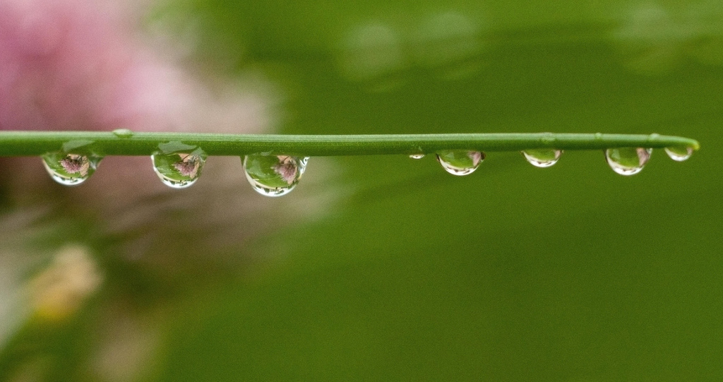
Adhesion
Adhesion is the attraction of molecules of one kind to molecules of a different kind. For e.g Water and Other Substances
Adhesion happens when water prefers to stick to other solid substances like a paper towel or the sides of a hollow tube, and and the water is pushed up
Because water molecules stick together, when the first water molecule sticks to the side of the tube and moves upward, it pulls the next water molecule up with it and so on, like a chain.
Adhesion is stronger than Cohesion

Slide 6
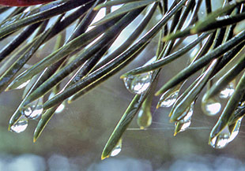
Example of Cohesion And Adhesion
The water drop is stuck to the end of a plant, which is an example of ADHESION, because it shows water sticking to a substance other than water
The water drop is made up of water molecules that like to stick together, making a water droplet and showing COHESION!

Slide 7
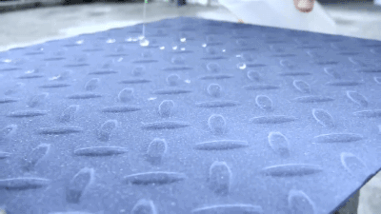
Hydrophobic
Hydrophobic literally means ‘the fear of water’
Nonpolar molecules that repel water molecules are said to be hydrophobic
Materials that are hydrophobic do not become wet easily when coming into contact with water
Hydrophobic molecules do not dissolve in water
Eg. oil and wax

Slide 8
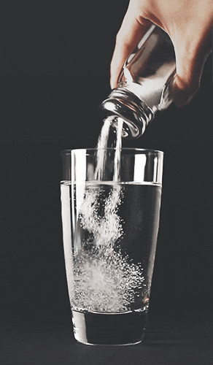
Hydrophilic
Hydrophobic literally means ‘water loving’
molecules forming ionic or a hydrogen bond with the water molecule are said to be hydrophilic
Materials that are hydrophilic readily dissolve in water or a watery solvent
Eg. Salt and sugar

Slide 9
Magic Sand Demo

Slide 10
Is magic sand hydrophobic or hydrophilic?

Slide 11
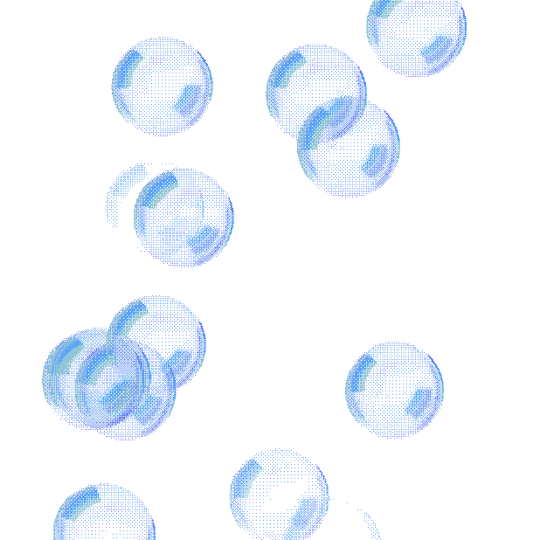
Surface tension in everyday life
Waxed cars
Mercury in thermometers
Oil and water
Insects walking on water
Tents
The shape of bubbles

Slide 12
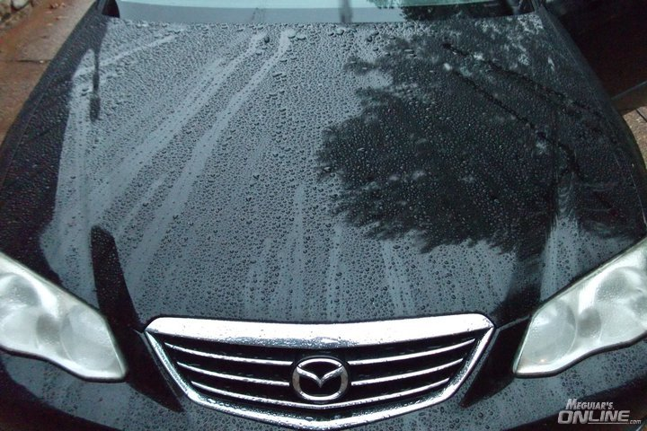
Waxed cars
Beading of water on waxed car: On a waxed car, the raindrops fall on the surface of the car and they smoothly slide down the side keeping the car neat and clean.

Slide 13
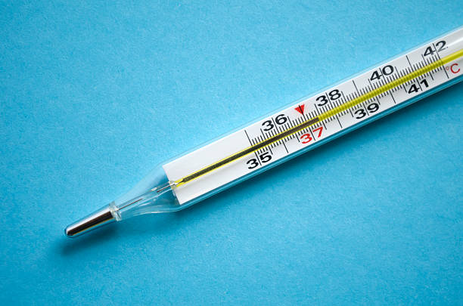
Mercury in thermometers
Mercury: The mercury in thermometers doesn't stick to the sides of the thermometer because of Surface Tension, If it did the temperature would be inaccurate.

Slide 14
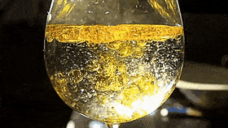
Oil and Water
Oil and Water: Separation between oil and water occurs due to the different surface tensions of the liquids

Slide 15
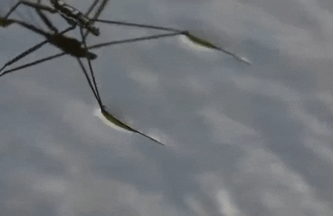
Insects walking on water
Walking on Water: Water insects are able to walk water because of the wax secreted on their legs combined with surface tension's elastic-like cover.

Slide 16
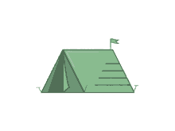
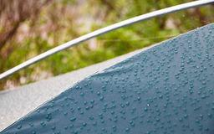
Water resistant Tents
The upper layer of some tents is the rain protector. When water is on it, the surface tension doesn't allow the water to pass through the tent cover. But if you touch the cover whilst the water is on it, you break the surface tension and the water slips through.

Slide 17
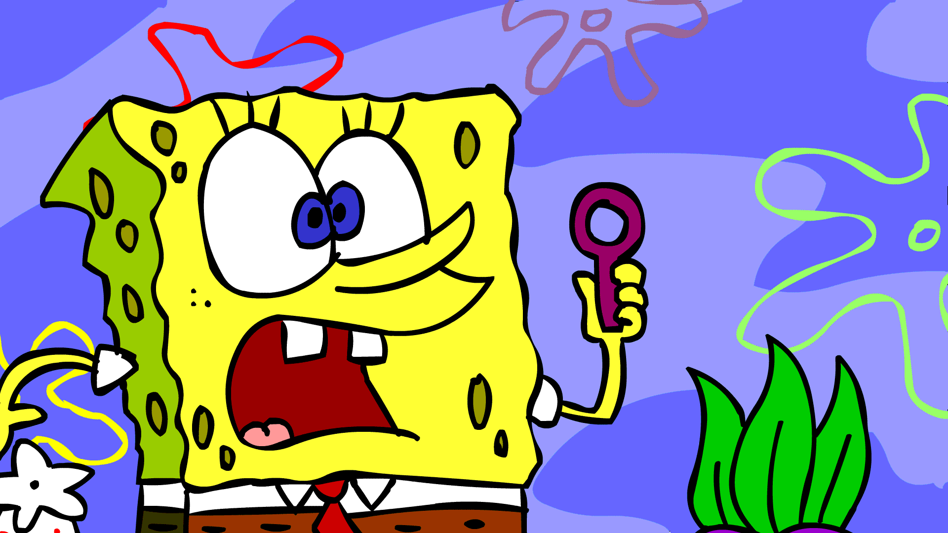
Why bubbles are round?
Bubbles: The surface of the soapy water is more flexible than ordinary water. When you blow air into soapy water, the air stretches the surface. The surface tension in this stretchy layer captures the air and pulls the soapy water into the shape of a sphere.

Slide 18
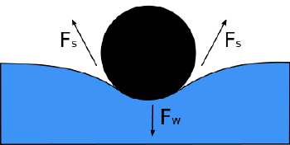
Surface tension of Water
Water has a very strong surface tension
Surface tension is the reason why water collects in drops
it is also why water can travel up a plant stem
Or get to your cells through the smallest blood vessels.
It even allows insects to walk on water!

Slide 19
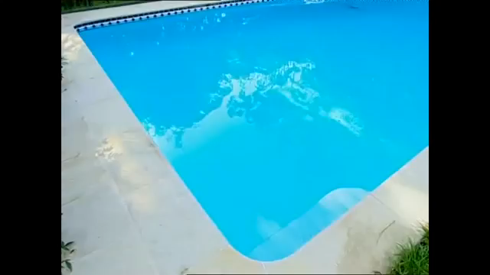
https://www.youtube.com/watch?v=A8n678m6ZqI
What do we see?
Noise?
Effect?
What happens when you break surface?
Discussion: How we can see/feel the surface tension of water when we dive?
Changes?

Slide 20
What do we see?
Noise?
Effect?
What happens when you break surface?
Discussion: How we can see/feel the surface tension of water when we dive?
Changes?

Slide 21
Experiment Time

Slide 22


WE DONE
Hope you enjoyed and learnt something new about Surface Tension!!

Slide 23
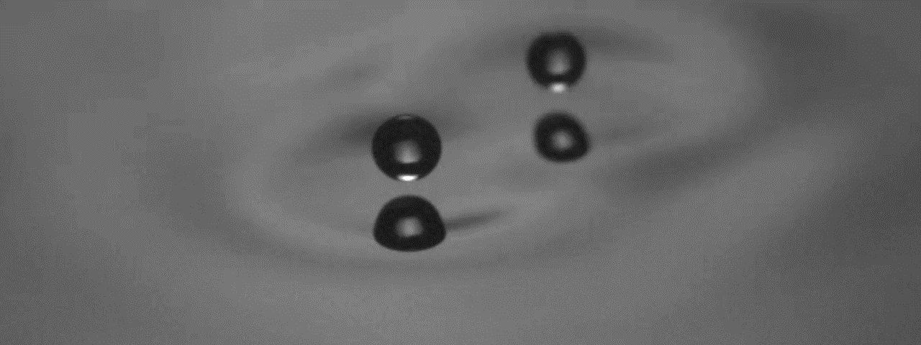
Rahil’s Walking Droplet

Slide 24


Slide 25
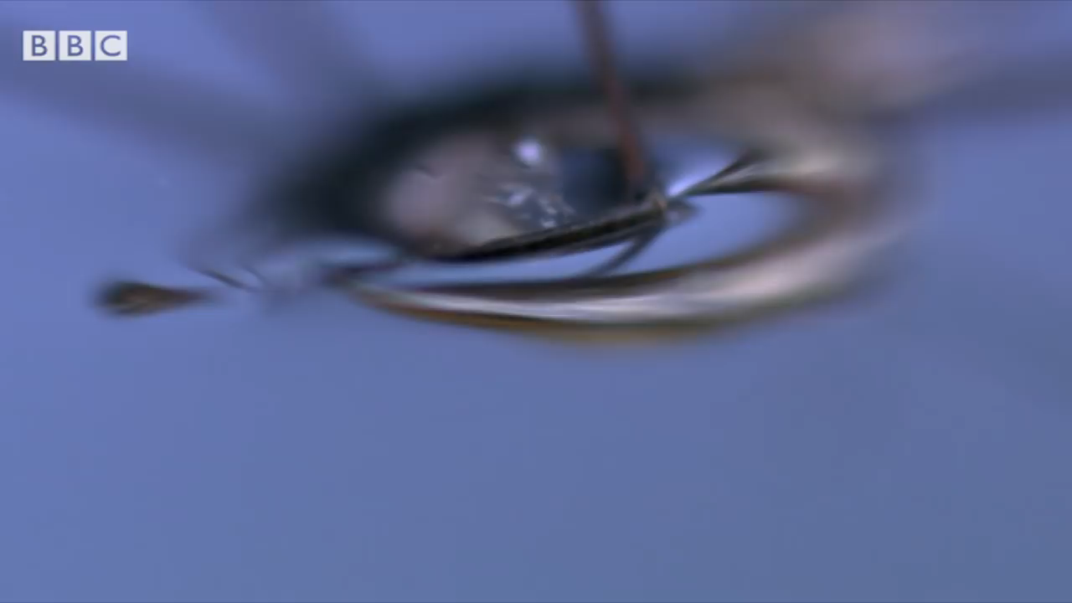

Slide 26
Extention for Experts

Slide 27
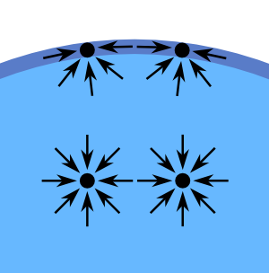
Cause of Surface Tension
The water molecules below the surface are pulled together equally from all directions on the surface of water have unequal pressure
However the molecules on the surface of the water have unequal pressure
This draws them together forming a ‘skin’
What we call surface tension

Slide 28
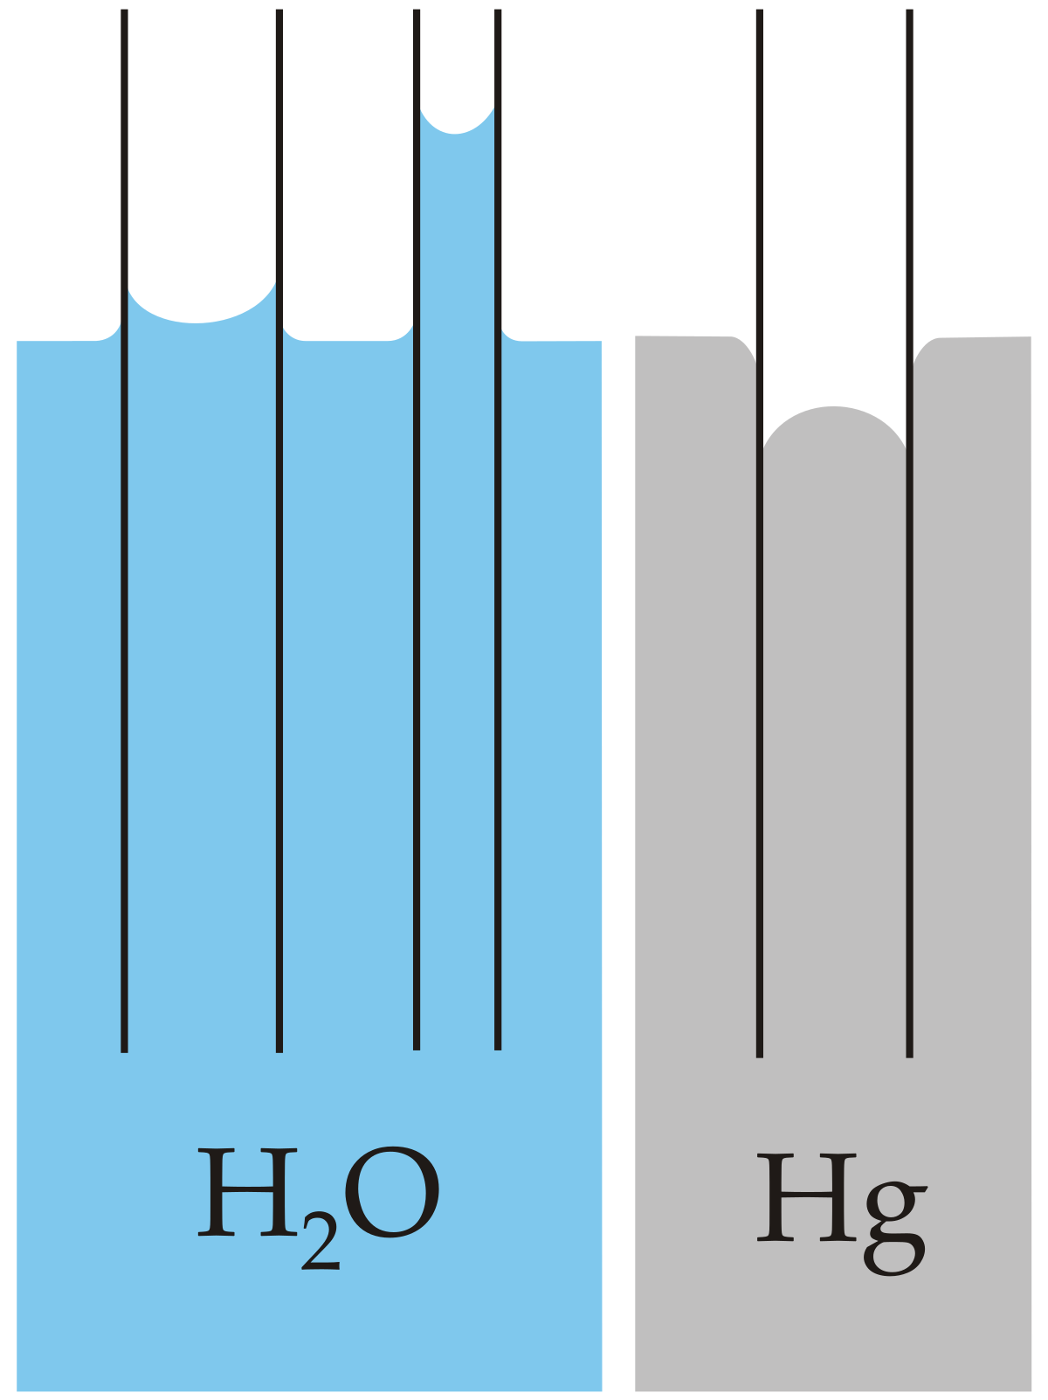
Capillary Action
Capillary action is the ability of a liquid to flow in narrow spaces without the assistance of, or even in opposition to, external forces like gravity.
This is due to adhesive and cohesive forces interacting between the liquid and the surface.

Slide 29
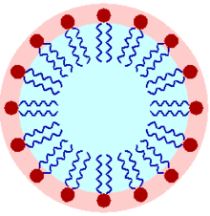
Surfactants
A surfactant is any molecule that reduces surface tension.
Surfactants are made up of two parts , one that attracts toward water and other that repels water. These help lower surface tension.
An example of a surfactant is soaps and detergents as they help us clean clothes by lowering the surface tension of the water so that it soaks into pores and soiled/dirty areas.

