Slide 1
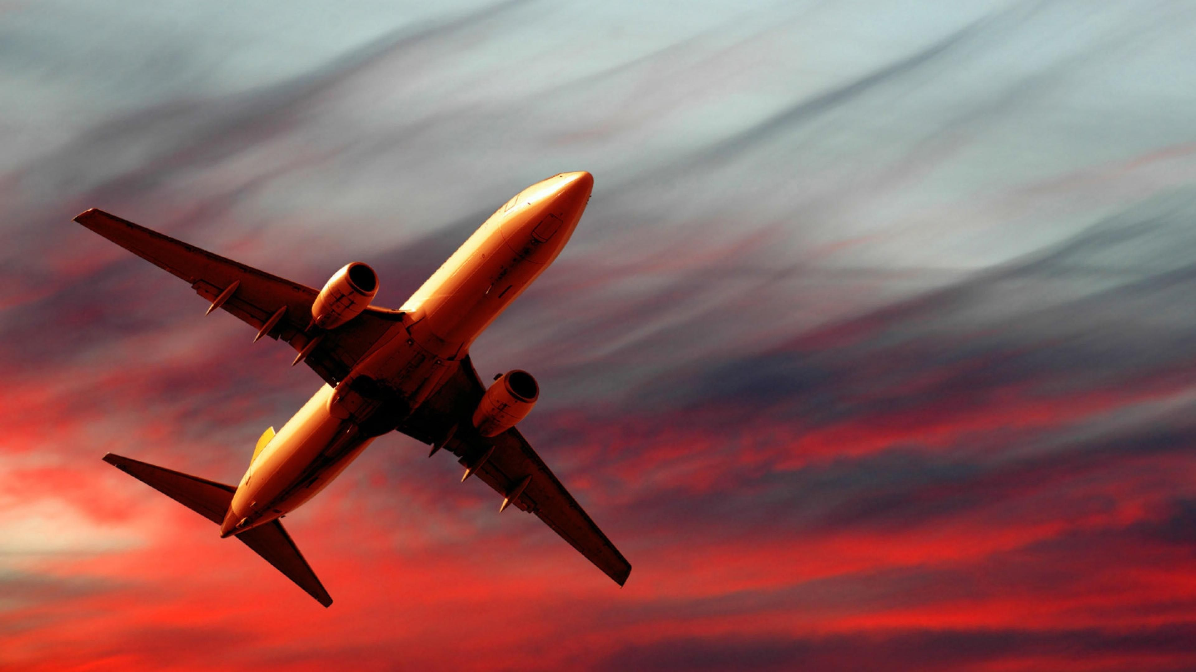
Flight

Slide 2
Wright Brothers – Areebah & Inaya

Slide 3
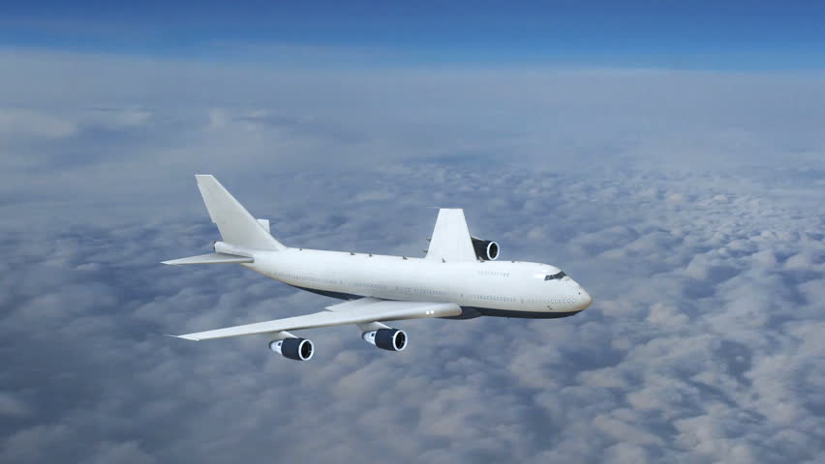
What forces are acting on a plane?
Lift
Drag
Thrust
Gravity

Slide 4
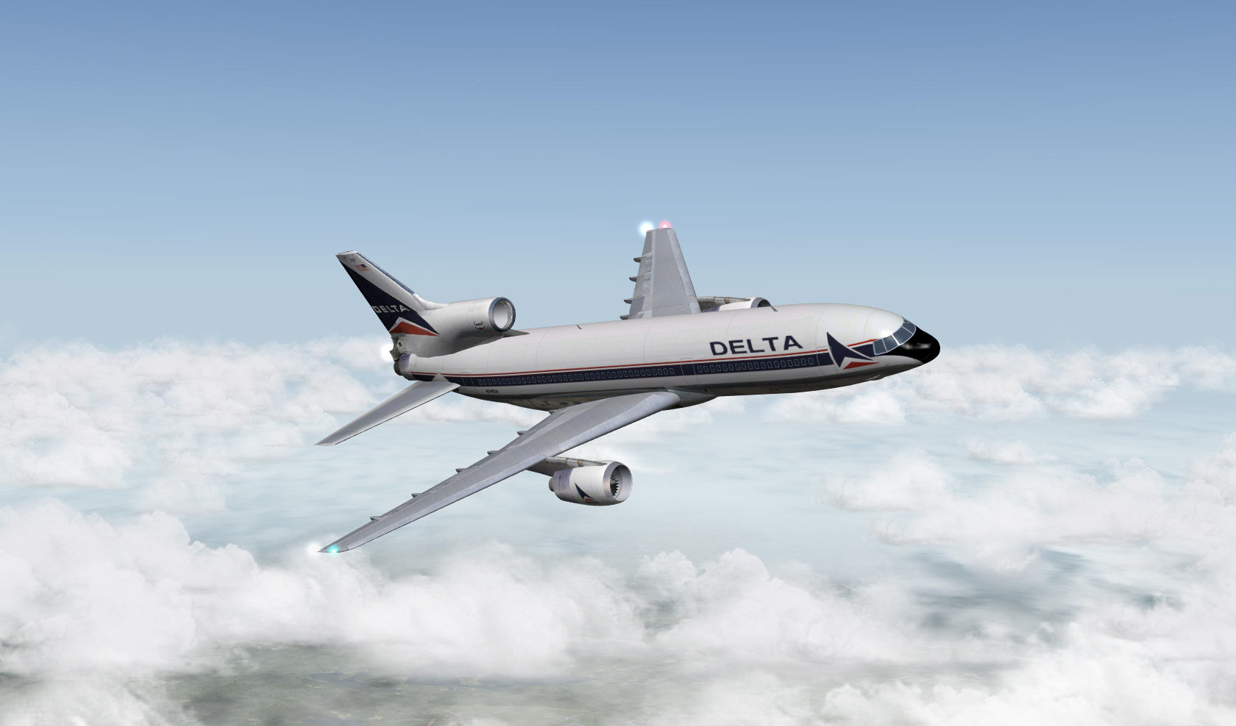
How do planes turn?

Slide 5
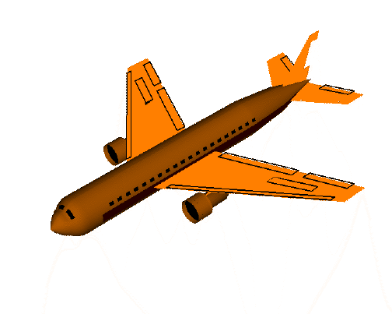

Slide 6
Yaw motion
Rudder

Slide 7
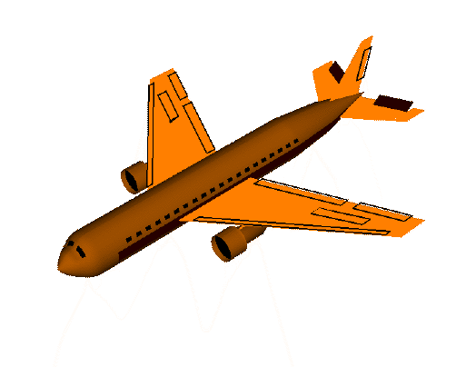

Slide 8
Pitch motion
Elevators

Slide 9
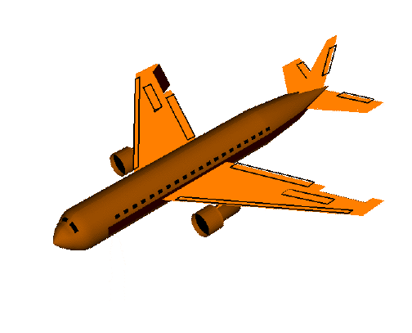

Slide 10
Roll motion
Ailerons

Slide 11
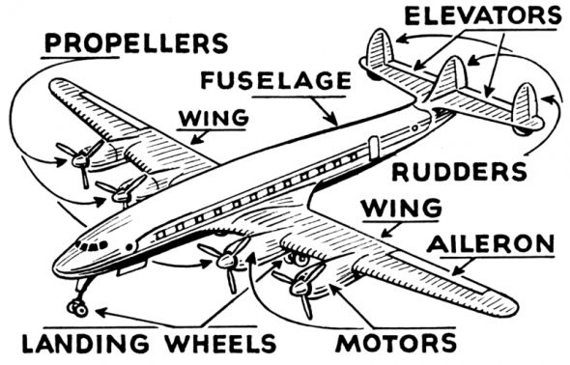

Slide 12
https://www.youtube.com/watch?v=ViKYFsN3p24

Slide 13
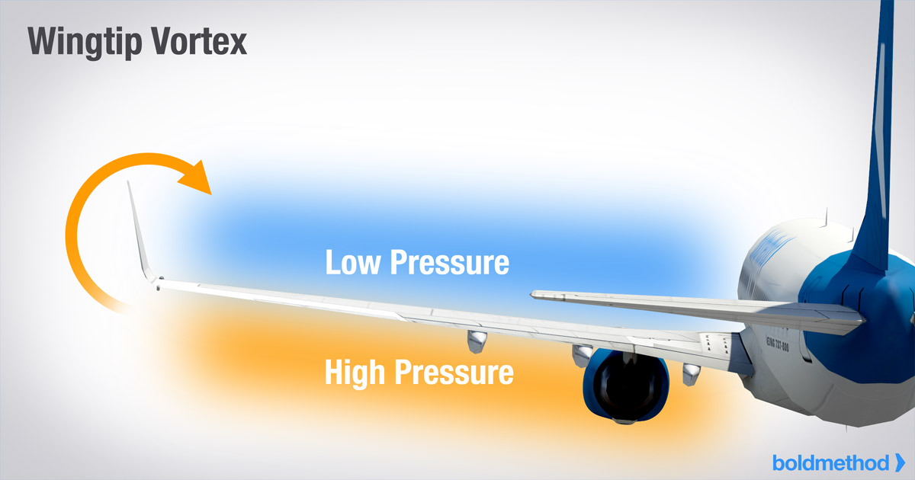

Slide 14
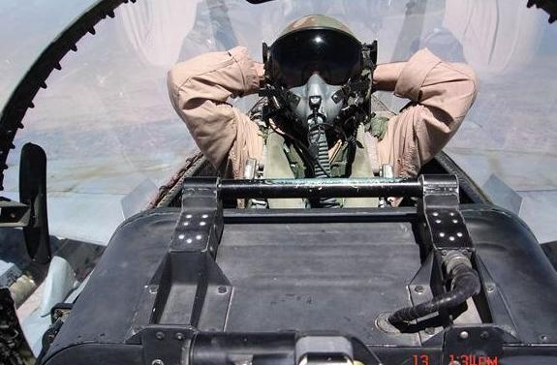

Slide 15
Why do aircraft windows need to
be open during takeoff/landing?

Slide 16
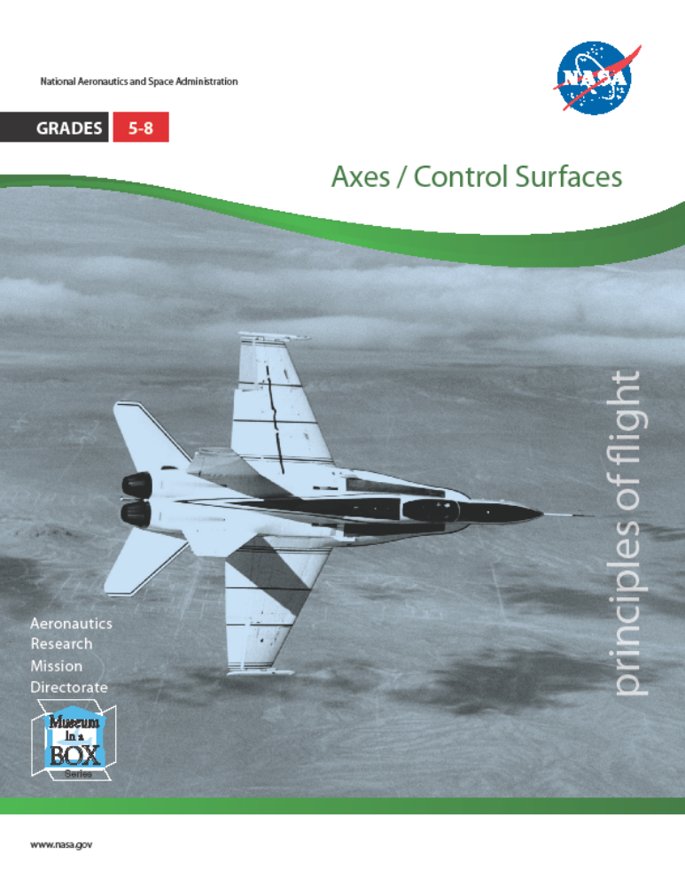
Control surface activities
https://www.scienceworld.ca/resources/activities/magnificent-flying-machines

