Slide 1
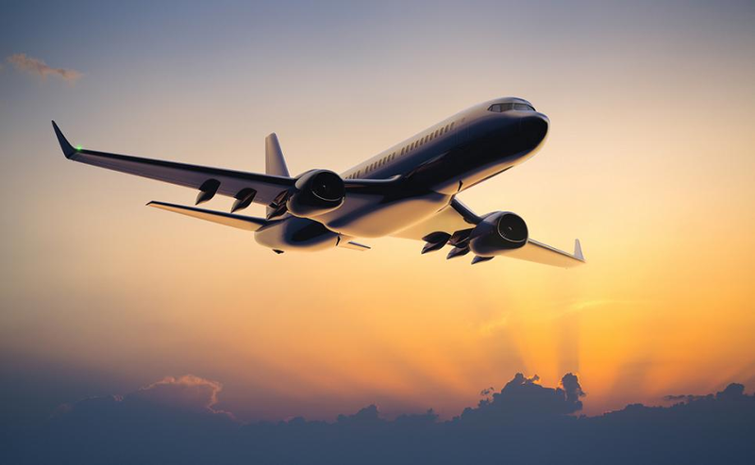
Flight

Slide 2
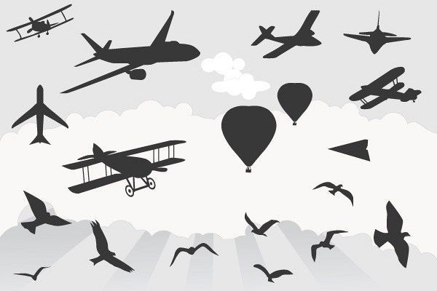
Can you name one thing that flies?

Slide 3
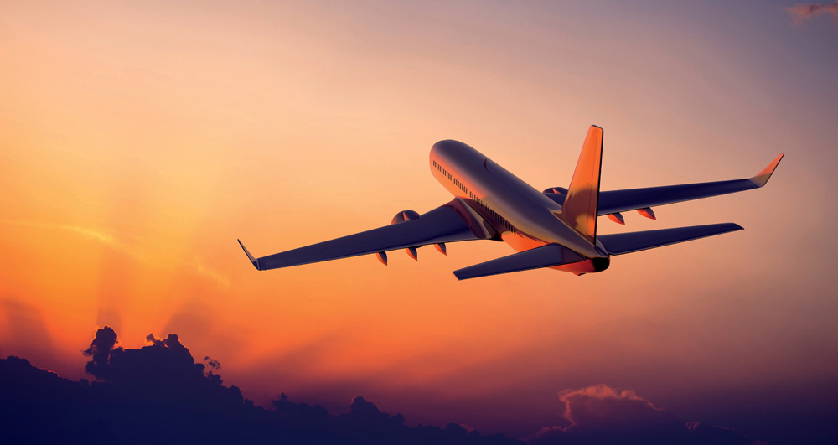
How does a plane fly?

Slide 4
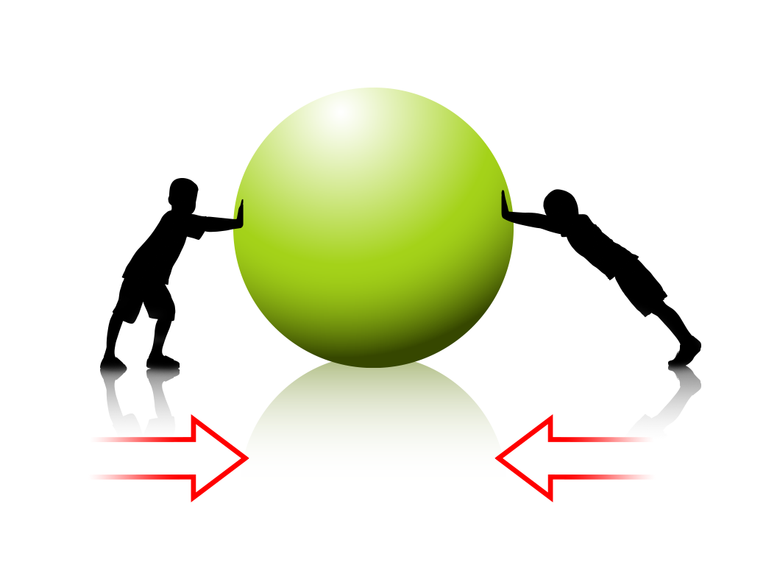
What is a Force?

Slide 5
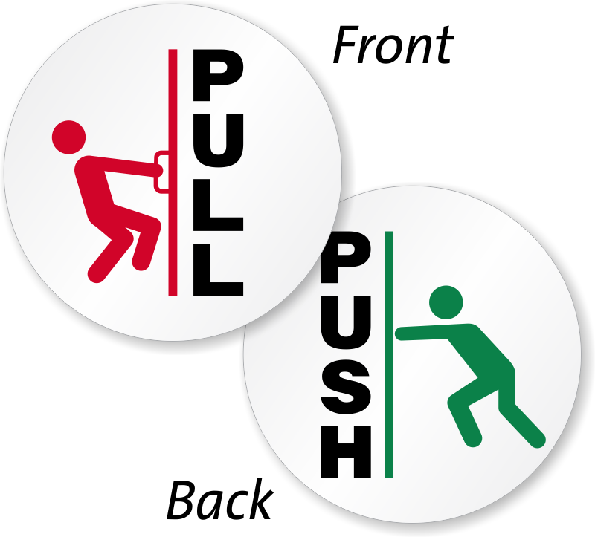
What is a Force?
Force is a push or pull!

Slide 6
What are some of different types Forces?

Slide 7

Gravitation force or Gravity

Slide 8

Frictional Force

Slide 9
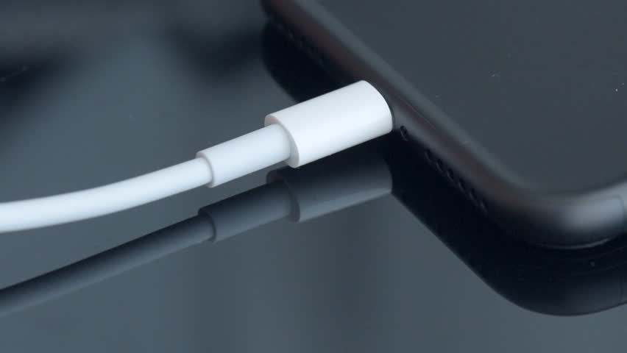
Electric force

Slide 10

Magnetic force

Slide 11
Force demonstration to show that an object moves in the direction of the total force.

Slide 12
What is a Air Pressure?

Slide 13
Balloon inside bottle demonstration

Slide 14
Air always moves from High pressure to Low pressure

Slide 15
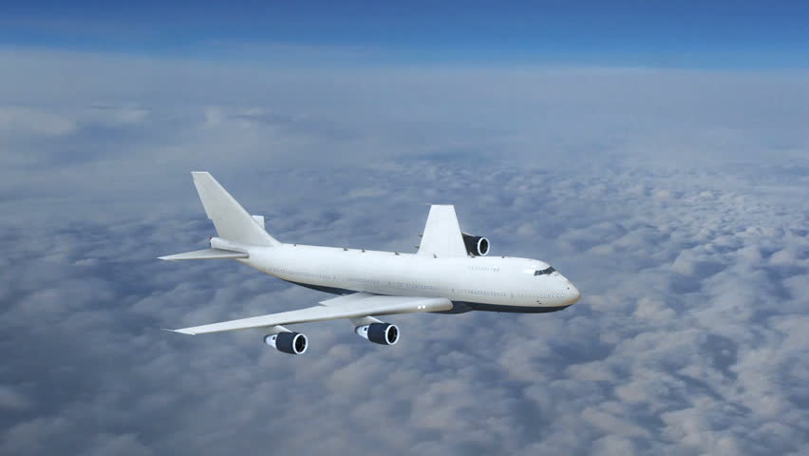
What forces are acting on a plane?

Slide 16
What forces are acting on a plane?
Gravity

Slide 17
What forces are acting on a plane?
Thrust
Gravity

Slide 18
What part of the plane generates the Thrust force?
Thrust
Gravity

Slide 19
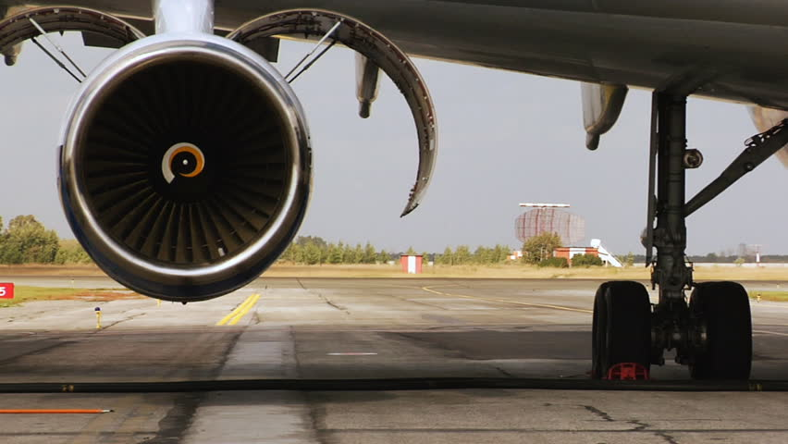
The engine!

Slide 20
What forces are acting on a plane?
Lift
Thrust
Gravity

Slide 21
What part of the plane generates the Lift force?
Lift
Thrust
Gravity

Slide 22
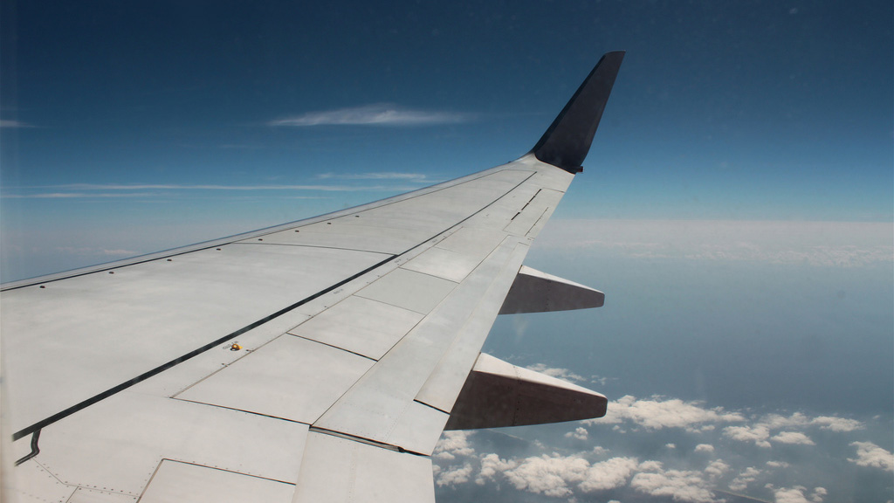
The wing!

Slide 23
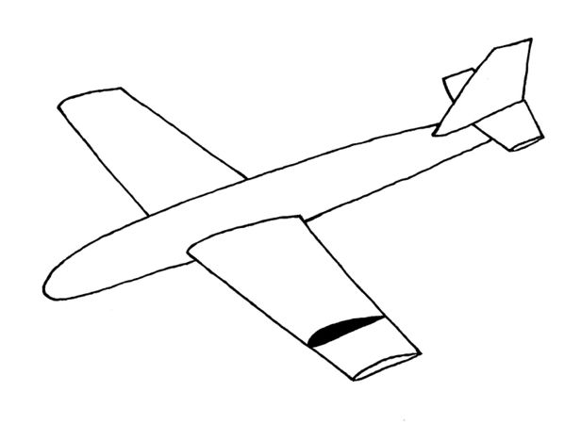
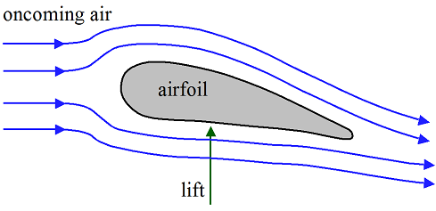
The wing!

Slide 24
What forces are acting on a plane?
Lift
Drag
Thrust
Gravity

Slide 25

What is Drag force?

Slide 26
What forces are acting on a plane?
Lift
Drag
Thrust
Gravity

Slide 27
Activities for the end of the day
End of Day 1

Slide 28
Paper Strip experiment

Slide 29
Blow air between two balloons experiment

