Slide 1
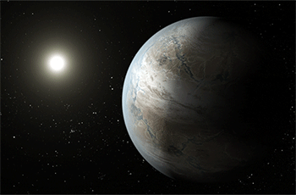
Astrobiology: is anyone out there?

Slide 2
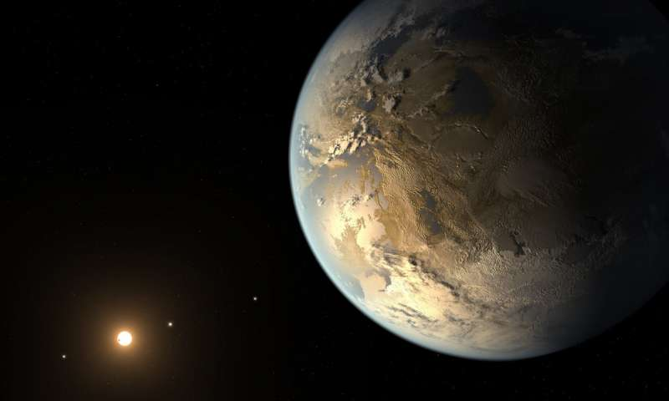
What is Biology?
Biology is the study of living things.
Biologists try to understand the natural world and the things that live in it. These things include plants, animals, fungi, protozoa, algae, bacteria, and viruses.

Slide 3
What is Astrobiology?
Astrobiology is the study of life in outer space. It looks for conditions necessary for life, like liquid water, a good temperature, or the presence of oxygen.

Slide 4
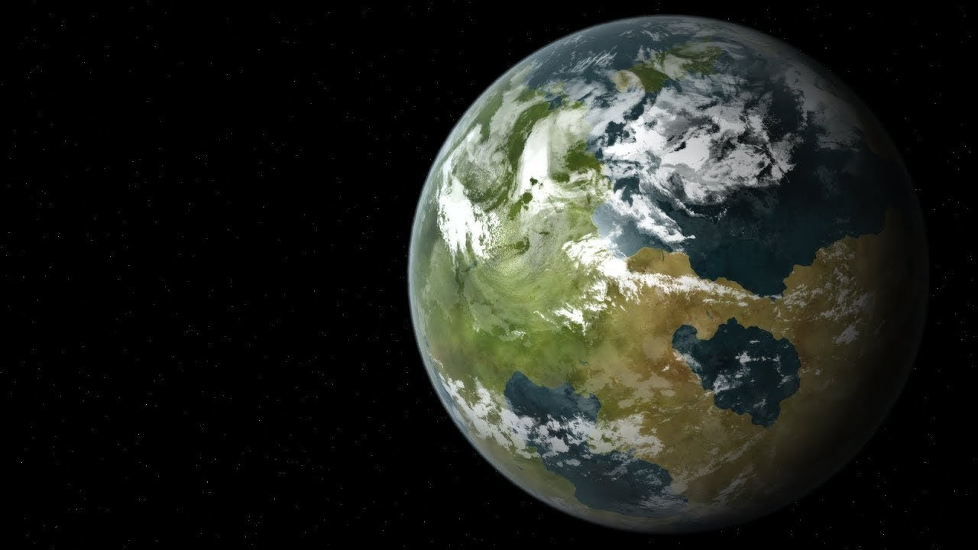
Who is alive?
How do you know if something is alive?
Notes:
Ask the participants, who is alive. Everybody’s hands will go up
Ask the participants how can they tell if something is alive? Get a few different participants to answer

Slide 5
How do we know if something is alive?
It moves around
It eats food to for nutrition
It breathes to make energy
Sense - how you understand what’s around you
Excretion - pooping, peeing and sweating
Reproduction - to have babies
Grow - to get bigger and older
Notes:
Some of the things listed here would have already been answered by the participants in the previous slide
Go through the ones they have missed

Slide 6
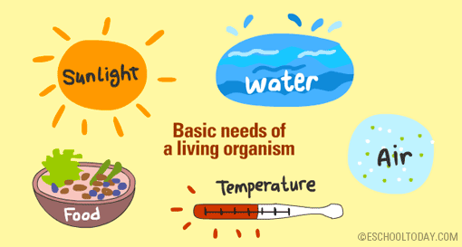
What does life need to survive?
Notes:
Ask participants – What does life need to survive?
Get a few responses from them and then show them this slide
Discuss each need briefly as follows
Sunlight: This is probably the most important need for all living organisms, because it is the source of all energy. It also provides heat for plants and animals
Water: Water is the medium in which living cells and tissue work. Water is also a living environment for many plants and animals
Air: Air is made up of several gases, but the two most important gases are Oxygen and Carbon dioxide. Without oxygen, animals will die, and without carbon dioxide, plants cannot survive.
Food (nutrients): Living things need energy for function. Energy is needed to grow, reproduce, move, and to work. Think of what will happen if you stayed for three days without food…
A Habitat with the Right Temperature: Too cold or too hot? Every living organism needs the ideal temperature to survive either on land or in water.

Slide 7
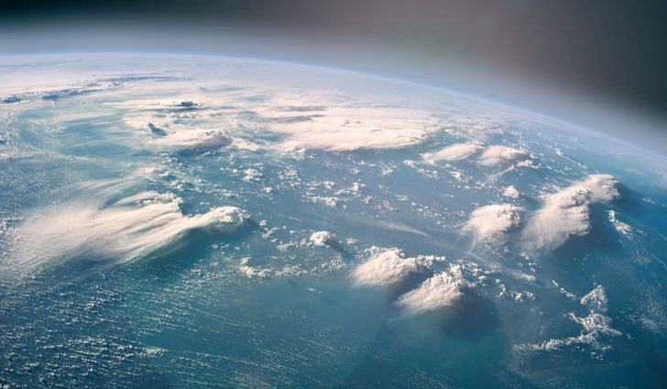
What should we look for to find life on other planets?
Liquid Water
Notes:
Ask participants that now that they know what are the basic things that life need to survive, what should we look for when searching for life on other planets?
Get a few different responses from different participants
Start with liquid water

Slide 8
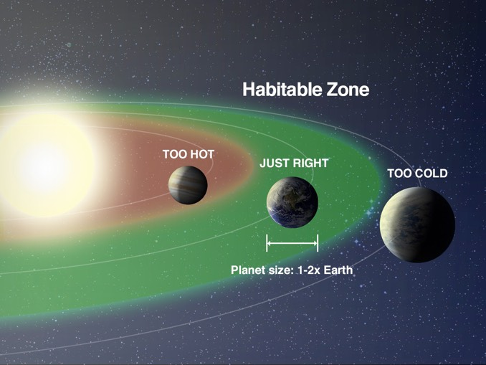
This means that the planet has to be the right distance from the Sun!
If it is too close the it will be too hot and the water will evaporate!
If it is too far then it will be too cold and the water will turn into ice!
Notes:
Point out to the participants that for a planet to have liquid water on its surface, it needs to be at the right distance from the star. This is called the Habitability Zone
If its too close then the planet will be too hot and the water will evaporate
If its too far then the planet will be too cold and the water will freeze

Slide 9
Habitable zone
Habitable zone also ensures that the planet gets enough energy from sunlight and has the right temperature as well!
Notes:
Habitability Zone also ensures that the planet gets enough sunlight from the star which the life can use as a source of energy
It also ensures a moderate temperature to give an environment for the life to thrive

Slide 10
What should we look for to find life on other planets?
Atmosphere to protect from harmful cosmic rays!
Notes:
Point out that other things life are likely to require is some sort of atmosphere which give the necessary air to breathe and protection from harmful cosmic radiation coming from space!

Slide 11
Activity 1: Where to Look for Life
Which planets and moons in our solar system are potentially habitable?
Notes:
Please refer to activity 1 instructions on how to conduct this activity

Slide 12
Sort habitability cards
into 3 piles:
Likely candidate in search for life
Unlikely candidate in search for life
Possible candidate in search for life

Slide 13
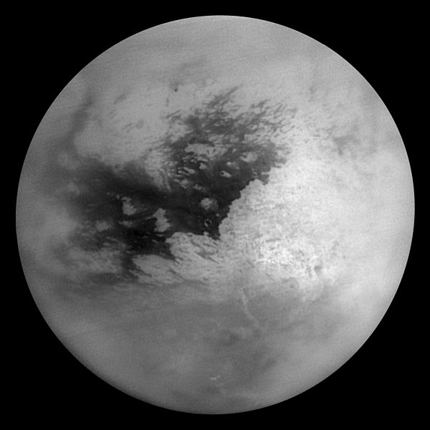
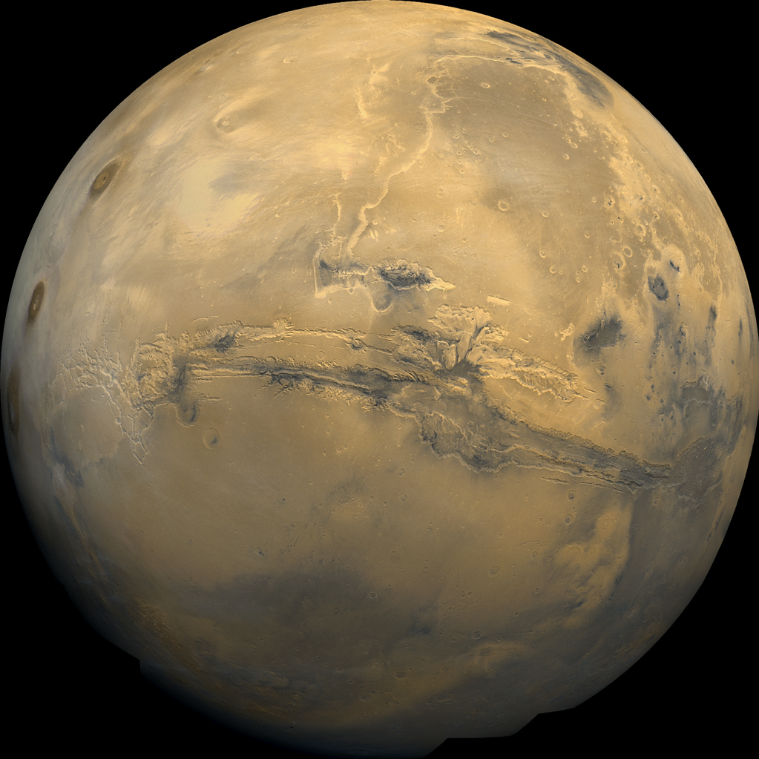
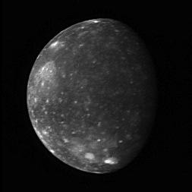
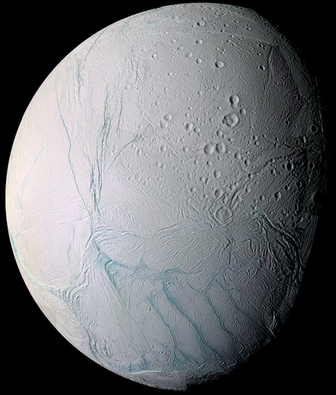
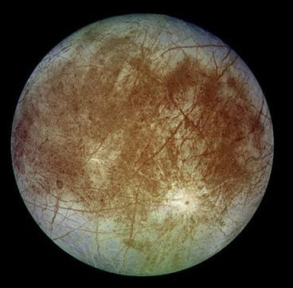
Likely & Possible
Titan
Callisto
Enceladus
Mars
Europa

Slide 14
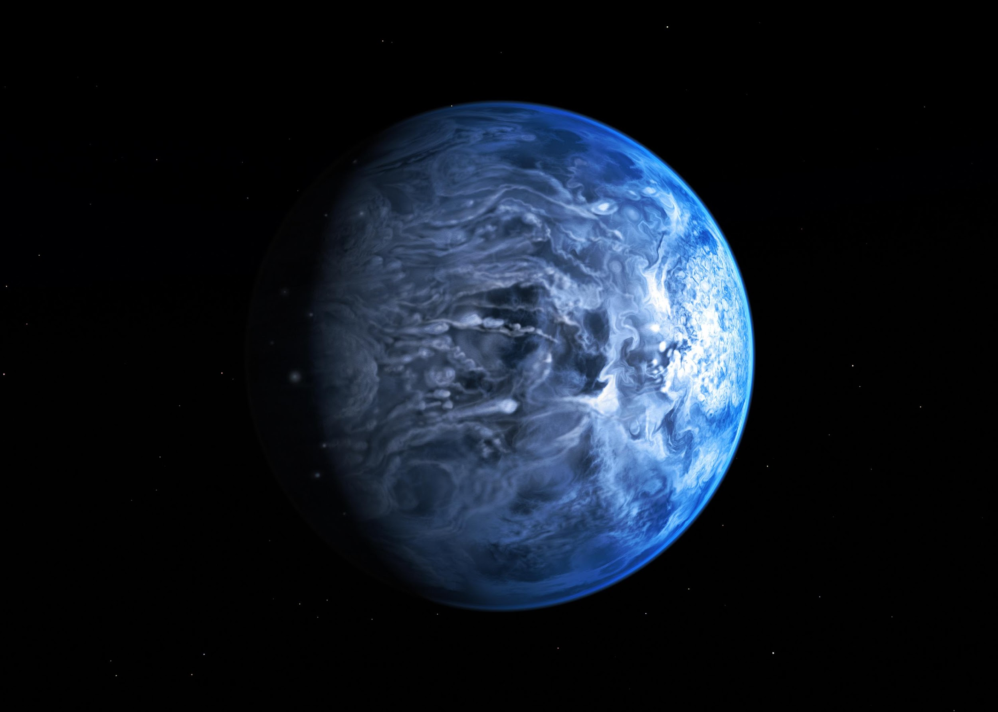
Exoplanets
All of the planets in our solar system orbit around the Sun. Planets that orbit around other stars are called exoplanets.
Notes:
From Activity 1, the participants would have identified which planets are likely/possible to harbour life in our Solar system
Ask the participants if they have ever heard of exoplanets and what they think it means
Explain exoplanets to the participants

Slide 15
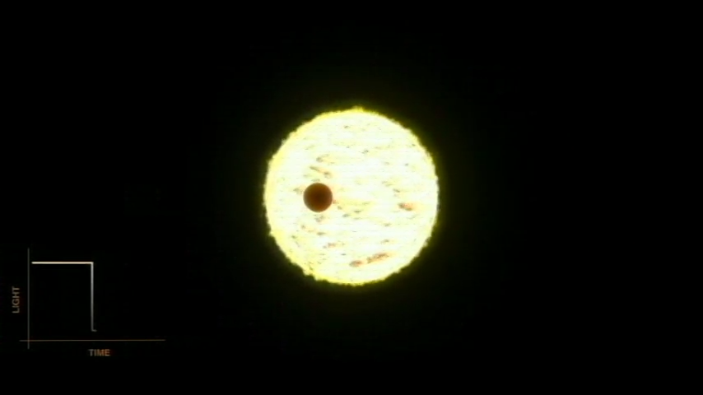
How do we find them?
Notes:
Ask the participants how might we find these exoplanets?
Point out that since these planets are part of other solar systems, they will be very far away and too small to observe directly
Show them the video and explain the transit method. In this method, exoplanets are detected by observing a dip in brightness of the light coming from a star when its planet passes right in front of it

Slide 16
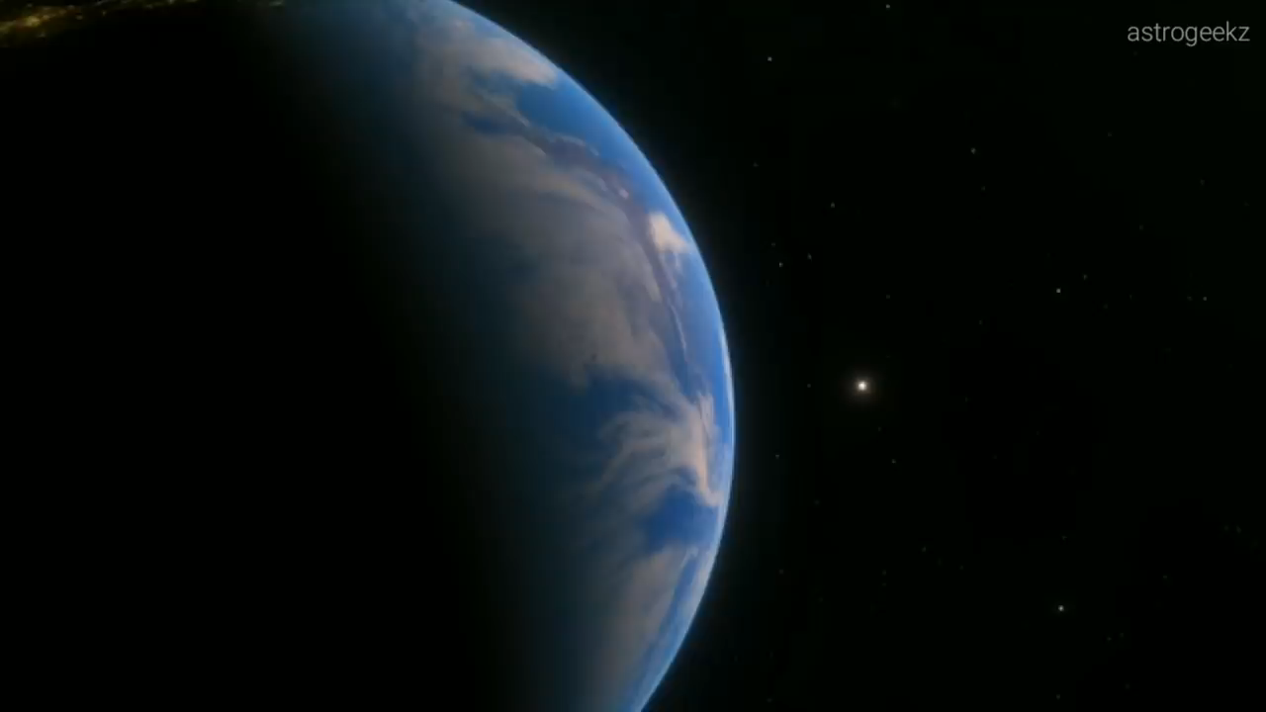
Have we found any Earth-like planets?
Notes:
Ask participants if they know of any exoplanets discovered that are like Earth?
Show them the video of Kepler 452-b which is an Earth like planet that was discoverd in 2015

Slide 17
Activity 2: Make your own creature
Notes:
Refer to the Activity 2 instruction

